Slide 1



Data Science and Machine Learning
Generative AI II

Slide 2
Generative AI & Large Language Models III

Slide 3
Fine-tuning with instruction prompts

Slide 4
GenAI project lifecycle
Scope
Select
Adapt and align model
Application integration
Define the problem
Choose model
Prompt engineering
Evaluate
Optimize and deploy model for inference
Augment model and build LLM- powered applications
Fine-tuning
Align with human feedback

Slide 5
GenAI project lifecycle
Scope
Select
Adapt and align model
Application integration
Define the problem
Choose model
Prompt engineering
Optimize and deploy model for inference
Augment model and build LLM- powered applications
Fine-tuning
Evaluate
Align with human feedback

Slide 6
Fine-tuning an LLM with instruction prompts

Slide 7

In-context learning (ICL) - zero shot inference
Prompt
Model
Completion
Classify this review: I loved this DVD!
Sentiment:
Classify this review: I loved this DVD!
Sentiment: Positive
LLM

Slide 8
In-context learning (ICL) - zero shot inference
Prompt
Model
Completion
Classify this review: I loved this DVD!
Sentiment:
Classify this review: I loved this DVD!
Sentiment: eived a very nice book review
LLM

Slide 9
In-context learning (ICL) - one/few shot inference
Prompt
Model
Completion
Classify this review: I loved this DVD!
Sentiment: Positive
Classify this review: I don’t like this chair.
Sentiment:
Classify this review: I loved this DVD!
Sentiment: Positive
Classify this review: I don’t like this chair.
Sentiment: Negative
LLM
One-shot or Few-shot Inference

Slide 10


Limitations of in-context learning
Context Window
Classify this review: I loved this movie!
Sentiment: Positive
Classify this review:
I don’t like this chair. Sentiment: Negative
Classify this review: This sofa is so ugly. Sentiment: Negative
Classify this review:
Who would use this product? Sentiment:
In-context learning may not work for smaller models LLM
Even with multiple examples
Examples take up space in the context window
Instead, try fine-tuning
the model

Slide 11


LLM fine-tuning at a high level
LLM pre-training
TEXT[...]
TEXT[...]
TEXT[...]
TEXT[...]
TEXT[...]
TEXT[...]
TEXT[...]
TEXT[...]
TEXT[...]
TEXT[...]
Model
Pre-trained LLM
GB - TB - PB
of unstructured textual data

Slide 12

LLM fine-tuning at a high level
LLM fine-tuning
Model
Task-specific examples
Model
TEXT[...], LABEL[...]
TEXT[...], LABEL[...]
TEXT[...], LABEL[...]
TEXT[...], LABEL[...]
TEXT[...], LABEL[...]
Pre-trained LLM
Fine-tuned LLM
GB - TB
of labeled examples for a specific task or set of tasks

Slide 13

LLM fine-tuning at a high level
LLM fine-tuning
Model
Task-specific examples
Model
PROMPT[...], COMPLETION[...]
PROMPT[...], COMPLETION[...]
PROMPT[...], COMPLETION[...]
PROMPT[...], COMPLETION[...]
PROMPT[...], COMPLETION[...]
Pre-trained LLM
Fine-tuned LLM
Improved performance
GB - TB
of labeled examples for a specific task or set of tasks
Prompt-completion pairs

Slide 14


Using prompts to fine-tune LLMs with instruction
LLM fine-tuning
Model
Model
Classify this review: I loved this DVD!
Sentiment: Positive
Pre-trained LLM
Fine-tuned LLM
Classify this review: I don’t like this chair.
Sentiment: Negative
Each prompt/completion pair includes a specific “instruction” to the LLM

Slide 15


Using prompts to fine-tune LLMs with instruction
LLM fine-tuning
Model
Task-specific examples
Model
PROMPT[...], COMPLETION[...]
PROMPT[...], COMPLETION[...]
PROMPT[...], COMPLETION[...]
PROMPT[...], COMPLETION[...]
PROMPT[...], COMPLETION[...]
Pre-trained LLM
Fine-tuned LLM
Summarize the following text: [EXAMPLE TEXT]
[EXAMPLE COMPLETION]
Translate this sentence to... [EXAMPLE TEXT]
[EXAMPLE COMPLETION]

Slide 16
Using prompts to fine-tune LLMs with instruction
LLM fine-tuning
Model
Task-specific examples
Model
PROMPT[...], COMPLETION[...]
PROMPT[...], COMPLETION[...]
PROMPT[...], COMPLETION[...]
PROMPT[...], COMPLETION[...]
PROMPT[...], COMPLETION[...]
Pre-trained LLM
Fine-tuned LLM
Full fine-tuning updates all parameters
Improved performance

Slide 17
Sample prompt instruction templates
Classification / sentiment analysis
Text generation
Text summarization
Source: https://github.com/bigscience-workshop/promptsource/blob/main/promptsource/templates/amazon_polarity/templates.yaml

Slide 18
LLM fine-tuning process
LLM fine-tuning
Prepared instruction dataset
Training splits
PROMPT[...], COMPLETION[...]
PROMPT[...], COMPLETION[...]
PROMPT[...], COMPLETION[...]
PROMPT[...], COMPLETION[...]
PROMPT[...], COMPLETION[...]
Training
PROMPT[...], COMPLETION[...]
...
Validation
PROMPT[...], COMPLETION[...]
...
Test

Slide 19


LLM fine-tuning process
LLM fine-tuning
LLM completion:
Classify this review: I loved this DVD!
Sentiment: Neutral
Prepared instruction dataset
Model
Pre-trained LLM
Prompt:
Classify this review: I loved this DVD! Sentiment:
Label:
Classify this review: I loved this DVD!
Sentiment: Positive

Slide 20

LLM fine-tuning process
LLM fine-tuning
LLM completion:
Classify this review: I loved this DVD!
Sentiment: Neutral
Prepared instruction dataset
Model
Pre-trained LLM
Label:
Prompt:
Classify this review: I loved this DVD!
Classify this review: I loved this DVD!
Sentiment: Positive
Sentiment:
Loss: Cross-Entropy

Slide 21
LLM fine-tuning process
LLM fine-tuning
Prepared instruction dataset
Training splits
PROMPT[...], COMPLETION[...]
PROMPT[...], COMPLETION[...]
PROMPT[...], COMPLETION[...]
PROMPT[...], COMPLETION[...]
PROMPT[...], COMPLETION[...]
Training
PROMPT[...], COMPLETION[...]
...
validation_accuracy
Validation
PROMPT[...], COMPLETION[...]
...
Test

Slide 22
LLM fine-tuning process
LLM fine-tuning
Prepared instruction dataset
Training splits
PROMPT[...], COMPLETION[...]
PROMPT[...], COMPLETION[...]
PROMPT[...], COMPLETION[...]
PROMPT[...], COMPLETION[...]
PROMPT[...], COMPLETION[...]
Training
PROMPT[...], COMPLETION[...]
...
Validation
PROMPT[...], COMPLETION[...]
...
Test
test_accuracy

Slide 23
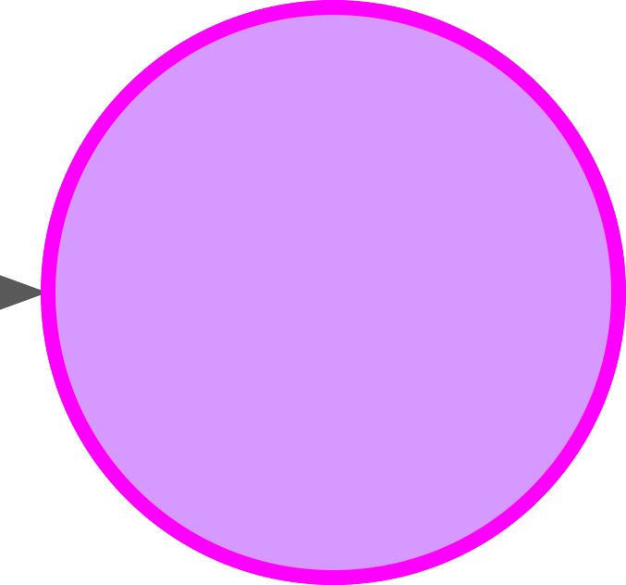
LLM fine-tuning process
Model
Model
Pre-trained LLM
Finetunned LLM

Slide 24
Fine-tuning on a single task

Slide 25

Fine-tuning on a single task
Model
Single-task training dataset,
e.g. summarization
Model
Pre-trained LLM
Summarize the following text:
[EXAMPLE TEXT] [EXAMPLE COMPLETION]
…
Instruct LLM
Summarize the following text:
[EXAMPLE TEXT] [EXAMPLE COMPLETION]
…
Summarize the following text:
[EXAMPLE TEXT] [EXAMPLE COMPLETION]
…
Summarize the following text:
[EXAMPLE TEXT] [EXAMPLE COMPLETION]
…
Often, only 500-1000 examples needed to fine-tune a single task

Slide 26
Catastrophic forgetting
Fine-tuning can significantly increase the performance of a model on a specific task…
Before fine-tuning
Prompt
Model
Completion
Classify this review: I loved this DVD!
Sentiment:
Classify this review: I loved this DVD!
Sentiment: eived a very nice book review
LLM

Slide 27
Catastrophic forgetting
Fine-tuning can significantly increase the performance of a model on a specific task…
After fine-tuning
Prompt
Model
Completion
Classify this review: I loved this DVD!
Sentiment:
Classify this review: I loved this DVD!
Sentiment: POSITIVE
LLM

Slide 28
Catastrophic forgetting
…but can lead to reduction in ability on other tasks
Before fine-tuning
Prompt
Model
Completion
What is the name of the cat?
Charlie the cat roamed the garden at night.
What is the name of the cat?
Charlie the cat roamed the garden at night.
Charlie
LLM

Slide 29
Catastrophic forgetting
…but can lead to reduction in ability on other tasks
After fine-tuning
Prompt
Model
Completion
What is the name of the cat?
Charlie the cat roamed the garden at night.
What is the name of the cat?
Charlie the cat roamed the garden at night.
The garden was positive.
LLM

Slide 30
How to avoid catastrophic forgetting
First note that you might not have to!
Fine-tune on multiple tasks at the same time
Consider Parameter Efficient Fine-tuning (PEFT)

Slide 31
Multi-task, instruction fine-tuning

Slide 32
Multi-task, instruction fine-tuning
Model
Instruction fine-tune on many tasks
Summarize the following text:
Pre-trained LLM
Rate this review:
Translate into Python code:
Identify the places:
…
[EXAMPLE TEXT] [EXAMPLE COMPLETION]

Slide 33

Multi-task, instruction fine-tuning
Model
Instruction fine-tune on many tasks
Model
Summarize the following text:
Pre-trained LLM
Instruct LLM
Rate this review:
Translate into Python code:
Identify the places:
…
Many examples of each needed for training
[EXAMPLE TEXT] [EXAMPLE COMPLETION]

Slide 34

Instruction fine-tuning with FLAN
FLAN models refer to a specific set of instructions used to perform instruction fine-tuning
“The metaphorical dessert to the main course of pretraining”
FLAN

Slide 35



Instruction fine-tuning with FLAN
FLAN models refer to a specific set of instructions used to perform instruction fine-tuning
T5
FLAN-T5
T5
FLAN
(Fine-tuned LAnguage Net)
PALM
FLAN-PALM
PALM

Slide 36
FLAN-T5: Fine-tuned version of pre-trained T5 model
FLAN-T5 is a great, general purpose, instruct model
T0-SF
Muffin
CoT (reasoning)
Natural Instructions
Commonsense Reasoning,
Question Generation,
Closed-book QA,
Adversarial QA,
Extractive QA
…
Natural language inference,
Code instruction gen,
Code repair
Dialog context generation,
Summarization (SAMSum)
…
Arithmetic reasoning,
Commonsense reasoning
Explanation generation,
Sentence composition,
Implicit reasoning,
…
Cause effect classification,
Commonsense reasoning,
Named Entity Recognition,
Toxic Language Detection,
Question answering
…
55 Datasets
14 Categories 193 Tasks
69 Datasets
27 Categories 80 Tasks
9 Datasets
1 Category 9 Tasks
372 Datasets
108 Categories 1554 Tasks
Source: Chung et al. 2022, “Scaling Instruction-Finetuned Language Models”

Slide 37
FLAN-T5: Fine-tuned version of pre-trained T5 model
FLAN-T5 is a great, general purpose, instruct model
T0-SF
Muffin
CoT (reasoning)
Natural Instructions
Commonsense Reasoning,
Question Generation,
Closed-book QA,
Adversarial QA,
Extractive QA
…
Natural language inference,
Code instruction gen,
Code repair
Dialog context generation,
Arithmetic reasoning,
Commonsense reasoning
Explanation generation,
Sentence composition,
Implicit reasoning,
…
Cause effect classification,
Commonsense reasoning,
Named Entity Recognition,
Toxic Language Detection,
Question answering
…
- Summarization (SAMSum)
…
55 Datasets
14 Categories 193 Tasks
69 Datasets
27 Categories 80 Tasks
9 Datasets
1 Category 9 Tasks
372 Datasets
108 Categories 1554 Tasks
Source: Chung et al. 2022, “Scaling Instruction-Finetuned Language Models”

Slide 38
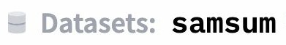
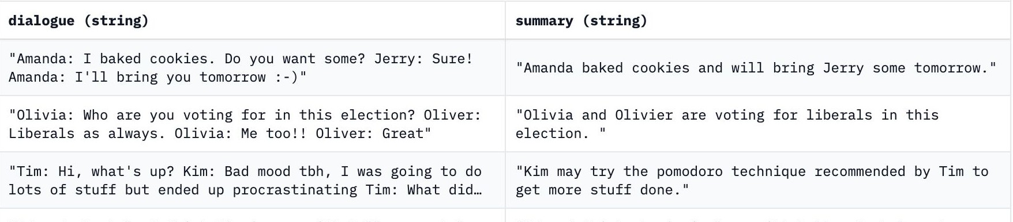
SAMSum: A dialogue dataset
Sample prompt training dataset (samsum) to fine-tune FLAN-T5 from pretrained T5
Source: https://huggingface.co/datasets/samsum, https://github.com/google-research/FLAN/blob/2c79a31/flan/v2/templates.py#L3285

Slide 39
Sample FLAN-T5 prompt templates
"samsum": [
("{dialogue}\n\Briefly summarize that dialogue.", "{summary}"),
("Here is a dialogue:\n{dialogue}\n\nWrite a short summary!", "{summary}"),
("Dialogue:\n{dialogue}\n\nWhat is a summary of this dialogue?", "{summary}"),
("{dialogue}\n\nWhat was that dialogue about, in two sentences or less?", "{summary}"),
("Here is a dialogue:\n{dialogue}\n\nWhat were they talking about?", "{summary}"),
("Dialogue:\n{dialogue}\nWhat were the main points in that "
"conversation?", "{summary}"),
("Dialogue:\n{dialogue}\nWhat was "{summary}"), | going | on | in | that | conversation?",
]

Slide 40
Sample FLAN-T5 prompt templates
"samsum": [
("{dialogue}\n\Briefly summarize that dialogue.", "{summary}"), ("Here is a dialogue:\n{dialogue}\n\nWrite a short summary!", "{summary}"),
("Dialogue:\n{dialogue}\n\nWhat is a summary of this dialogue?", "{summary}"),
("{dialogue}\n\nWhat was that dialogue about, in two sentences or less?", "{summary}"),
("Here is a dialogue:\n{dialogue}\n\nWhat were they talking about?", "{summary}"),
("Dialogue:\n{dialogue}\nWhat were the main points in that "
"conversation?", "{summary}"),
("Dialogue:\n{dialogue}\nWhat was | going | on | in | that | conversation?",
"{summary}"),
]

Slide 41
Improving FLAN-T5’s summarization capabilities
ShopBot
Hi there! How can I help you today?
I need to return a pair of jeans that I purchased
Of course, I’d be happy to help you. When did you buy your item?
T
Two weeks ago.
T

Slide 42
Improving FLAN-T5’s summarization capabilities
ShopBot
Hi there! How can I help you today?
Goal: Summarize conversations to identify actions to take
I need to return a pair of jeans that I purchased
Of course, I’d be happy to help you. When did you buy your item?
T
Two weeks ago.
T

Slide 43
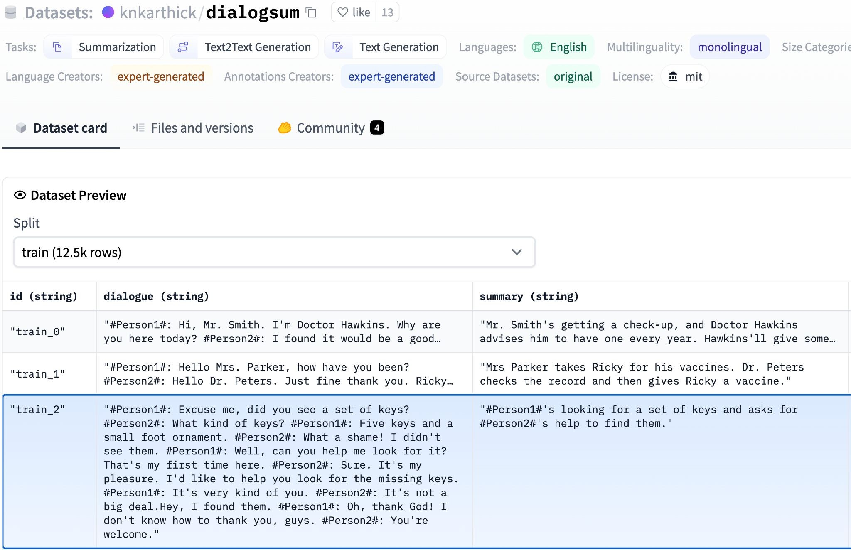
Improving FLAN-T5’s summarization capabilities
Further fine-tune FLAN-T5 with a domain-specific instruction dataset (dialogsum)

Slide 44
Example support-dialog summarization
Prompt (created from template)
Summarize the following conversation.
Tommy: Hello. My name is Tommy Sandals, I have a reservation. Mike: May I see some identification, sir, please?
Tommy: Sure. Here you go.
Mike: Thank you so much. Have you got a credit card, Mr. Sandals?
Tommy: I sure do.
Mike: Thank you, sir. You'll be in room 507, nonsmoking, queen bed.
Tommy: That's great, thank you! Mike: Enjoy your stay!
Source: https://huggingface.co/datasets/knkarthick/dialogsum/viewer/knkarthick--dialogsum/

Slide 45
Summary before fine-tuning FLAN-T5 with our dataset
Prompt (created from template)
Model
Completion (Summary)
Summarize the following conversation.
Tommy: Hello. My name is Tommy Sandals, I have a reservation.
Mike: May I see some
...
...
...
Tommy: That's great, thank you!
Mike: Enjoy your stay!
Tommy Sandals has a reservation for a room at the Venetian Hotel in Las Vegas.
FLAN-T5
Adequate completion, but does not match human baseline.
Human baseline summary:
Tommy Sandals has got a reservation. Mike asks for his identification and credit card and helps his check-in.

Slide 46
Summary before fine-tuning FLAN-T5 with our dataset
Prompt (created from template)
Model
Completion (Summary)
Summarize the following conversation.
Tommy: Hello. My name is Tommy Sandals, I have a reservation.
Mike: May I see some
...
...
...
Tommy: That's great, thank you!
Mike: Enjoy your stay!
Tommy Sandals has a reservation
for a room at the
Venetian
FLAN-T5
Hotel in Las Vegas.
Adequate completion, but does not match human baseline.
Human baseline summary:
Tommy Sandals has got a reservation. Mike asks for his identification and credit card and helps his check-in.

Slide 47
Summary before fine-tuning FLAN-T5 with our dataset
Prompt (created from template)
Model
Completion (Summary)
Summarize the following conversation.
Tommy: Hello. My name is Tommy Sandals, I have a reservation.
Mike: May I see some
...
...
...
Tommy: That's great, thank you!
Mike: Enjoy your stay!
Tommy Sandals has a reservation for a room at the Venetian
FLAN-T5
Hotel in
Las Vegas.
Adequate completion, but does not match human baseline.
Human baseline summary:
Tommy Sandals has got a reservation. Mike asks for his identification and credit card and helps his check-in.

Slide 48
Summary after fine-tuning FLAN-T5 with our dataset
Prompt (created from template)
Model
Completion (Summary)
Summarize the following conversation.
Tommy: Hello. My name is Tommy Sandals, I have a reservation.
Mike: May I see some
...
...
...
Tommy: That's great, thank you!
Mike: Enjoy your stay!
Tommy Sandals has a reservation and checks in showing his ID and credit card. Mike helps him to check in and approves his reservation.
FLAN-T5
(Fine-tuned)
Better summary, more-closely matches human baseline.

Slide 49
Fine-tuning with your own data
ShopBot
Hi there! How can I help you today?
I need to return a pair of jeans that I purchased
Of course, I’d be happy to help you. When did you buy your item?
T
Two weeks ago.
T

Slide 50
Model evaluation metrics

Slide 51
LLM Evaluation - Challenges
Correct Predictions
Accuracy =
Total Predictions

Slide 52



LLM Evaluation - Challenges
“Mike really loves drinking tea.”
“Mike adores sipping tea.”
=
=
“Mike does not drink coffee.”
“Mike does drink coffee.”

Slide 53
LLM Evaluation - Metrics
BLEU SCORE
ROUGE
Used for text summarization
Compares a summary to one or more reference summaries
Used for text translation
Compares to human-generated translations

Slide 54
LLM Evaluation - Metrics - Terminology
n-gram
The dog lay on the rug as I sipped a cup of tea. bigram unigram

Slide 55
LLM Evaluation - Metrics - ROUGE-1
Reference (human):
It is cold outside.
ROUGE-1
Recall
unigram matches unigrams in reference
4
4
=
=
= 1.0
Generated output:
It is very cold outside.
ROUGE-1
Precision:
unigram matches unigrams in output
4
5
=
=
= 0.8
ROUGE-1 F1:
₂ precision x recall
0.8
1.8
=
= 2
= 0.89
precision + recall

Slide 56
LLM Evaluation - Metrics - ROUGE-1
Reference (human):
It is cold outside.
ROUGE-1
Recall
unigram matches unigrams in reference
4
4
=
=
= 1.0
Generated output:
It is not cold outside.
ROUGE-1
Precision:
unigram matches unigrams in output
4
5
=
=
= 0.8
ROUGE-1 F1:
₂ precision x recall
0.8
1.8
=
= 2
= 0.89
precision + recall

Slide 57
LLM Evaluation - Metrics - ROUGE-2
Reference (human):
It is cold outside.
It is is cold cold outside
Generated output:
It is very cold outside.
It is is very very cold
cold outside

Slide 58
LLM Evaluation - Metrics - ROUGE-2
Reference (human):
It is cold outside.
It is is cold
cold outside
ROUGE-2
Recall:
bigram matches bigrams in reference
2
3
=
=
= 0.67
ROUGE-2
Precision:
bigram matches bigrams in output
2
4
=
=
= 0.5
Generated output:
It is very cold outside.
It is
very cold
is very
cold outside
₂ precision x recall
ROUGE-2 F1:
=
precision + recall
= 2 ^{0.335} = 0.57
1.17

Slide 59
LLM Evaluation - Metrics - ROUGE-L
Reference (human):
It is cold outside.
Generated output:
It is very cold outside.
Longest common subsequence (LCS):
It is
2
cold outside

Slide 60
LLM Evaluation - Metrics - ROUGE-L
Reference (human):
It is cold outside.
ROUGE-L
Recall:
LCS(Gen, Ref) unigrams in reference
2
4
=
=
= 0.5
Generated output:
It is very cold outside.
ROUGE-L
Precision:
LCS(Gen, Ref) unigrams in output
2
5
=
=
= 0.4
ROUGE-L F1:
₂ precision x recall
0.2
0.9
=
= 2
= 0.44
precision + recall

Slide 61
LLM Evaluation - Metrics - ROUGE-L
Reference (human):
It is cold outside.
ROUGE-L
Recall:
LCS(Gen, Ref) unigrams in reference
2
4
=
=
= 0.5
Generated output:
It is very cold outside.
ROUGE-L
Precision:
LCS(Gen, Ref) unigrams in output
2
5
=
=
= 0.4
LCS:
Longest common subsequence
ROUGE-L F1:
₂ precision x recall
0.2
0.9
=
= 2
= 0.44
precision + recall

Slide 62
LLM Evaluation - Metrics - ROUGE hacking
Reference (human):
It is cold outside.
Generated output:
cold cold cold cold

Slide 63


LLM Evaluation - Metrics - ROUGE clipping
Reference (human):
It is cold outside.
Generated output:
cold cold cold cold
ROUGE-1
Precision
unigram matches unigrams in output
4
4
=
=
= 1.0
Modified precision
clip(unigram matches) unigrams in output
1
4
=
=
= 0.25
Generated output:
outside cold it is
Modified precision
clip(unigram matches) ₌
4
4
=
= 1.0
unigrams in output

Slide 64
LLM Evaluation - Metrics
BLEU SCORE
ROUGE
Used for text summarization
Compares a summary to one or more reference summaries
Used for text translation
Compares to human-generated translations

Slide 65
LLM Evaluation - Metrics - BLEU
BLEU metric = Avg(precision across range of n-gram sizes)
Reference (human):
I am very happy to say that I am drinking a warm cup of tea.
Generated output:
I am very happy that I am drinking a cup of tea. - BLEU 0.495
I am very happy that I am drinking a warm cup of tea. - BLEU 0.730 I am very happy to say that I am drinking a warm tea. - BLEU 0.798
I am very happy to say that I am drinking a warm cup of tea. - BLEU 1.000

Slide 66
LLM Evaluation - Metrics
BLEU SCORE
ROUGE
Used for text summarization
Compares a summary to one or more reference summaries
Used for text translation
Compares to human-generated translations

Slide 67
Benchmarks

Slide 68



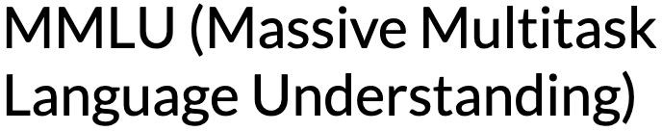
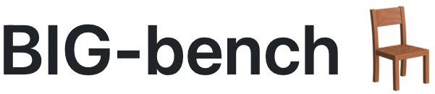



Evaluation benchmarks

Slide 69
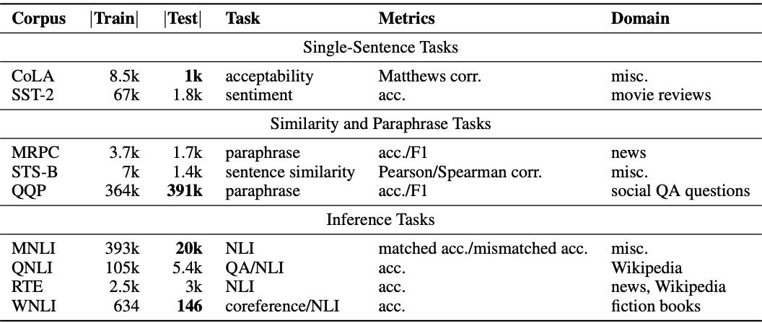
GLUE
The tasks included in SuperGLUE benchmark:
Source: Wang et al. 2018, “GLUE: A Multi-Task Benchmark and Analysis Platform for Natural Language Understanding”

Slide 70
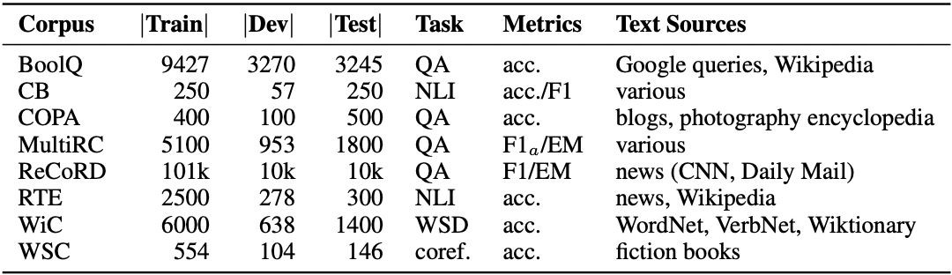
SuperGLUE
The tasks included in SuperGLUE benchmark:
Source: Wang et al. 2019, “SuperGLUE: A Stickier Benchmark for General-Purpose Language Understanding Systems“

Slide 71
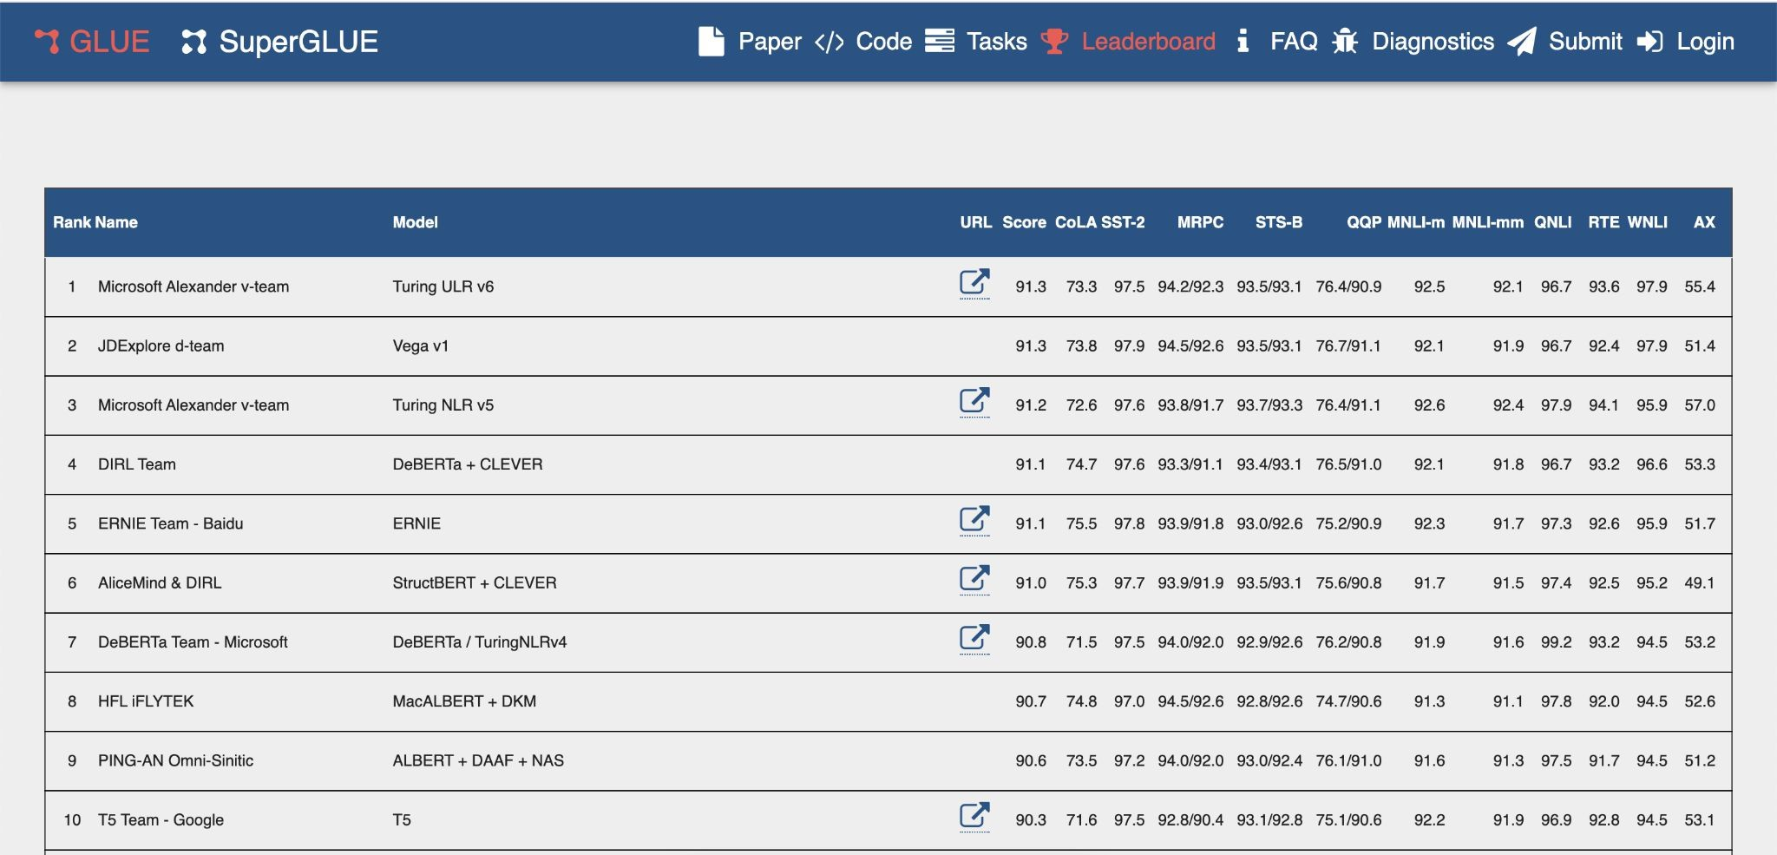
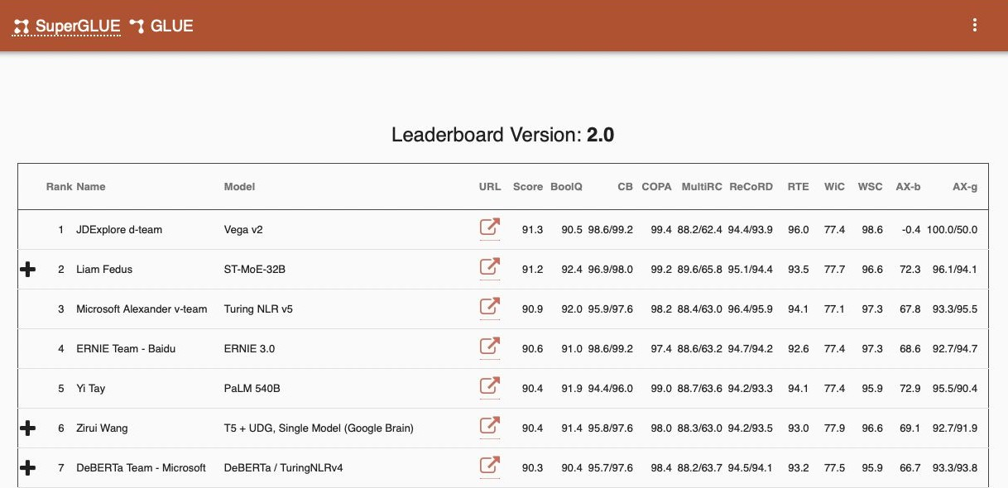
GLUE and SuperGLUE leaderboards
Disclaimer: metrics may not be up-to-date.
Check https://super.gluebenchmark.com and https://gluebenchmark.com/leaderboard for the latest.

Slide 72
Benchmarks for massive models
Massive Multitask Language Understanding (MMLU)
2021
Source: Hendrycks, 2021. “Measuring Massive Multitask Language Understanding”

Slide 73
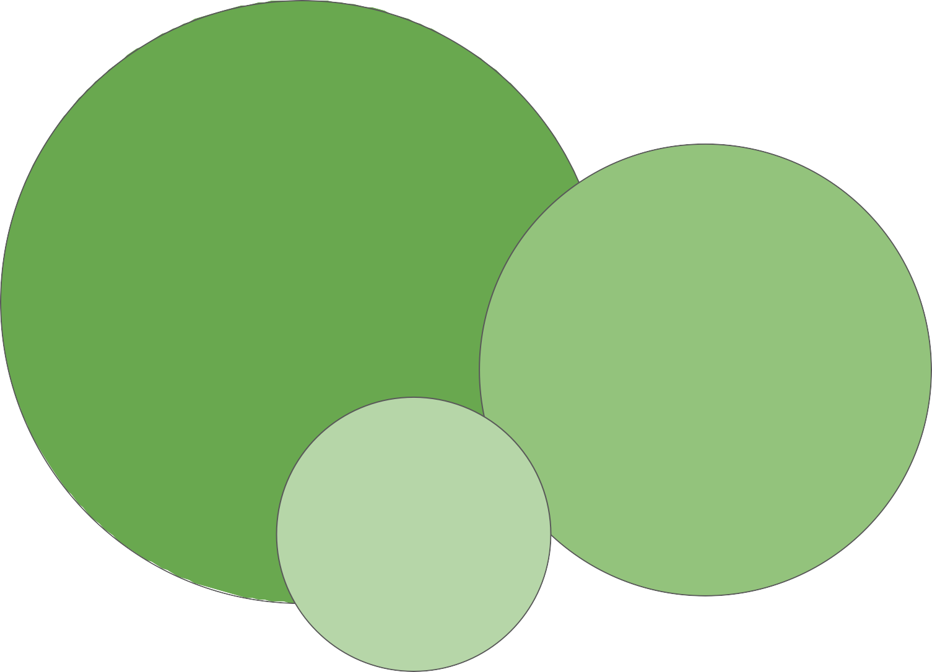
Benchmarks for massive models
Massive Multitask Language Understanding (MMLU)
BIG-bench Hard
BIG-bench
Lite
2021
2022
Source: Hendrycks, 2021. “Measuring Massive Multitask Language Understanding”
Source: Suzgun et al. 2022. “Challenging BIG-Bench tasks and whether chain-of-thought can solve them“

Slide 74
Benchmarks for massive models
Massive Multitask Language Understanding (MMLU)
BIG-bench Hard
BIG-bench
Lite
2021
2022
Source: Hendrycks, 2021. “Measuring Massive Multitask Language Understanding”
Source: Suzgun et al. 2022. “Challenging BIG-Bench tasks and whether chain-of-thought can solve them“

Slide 75
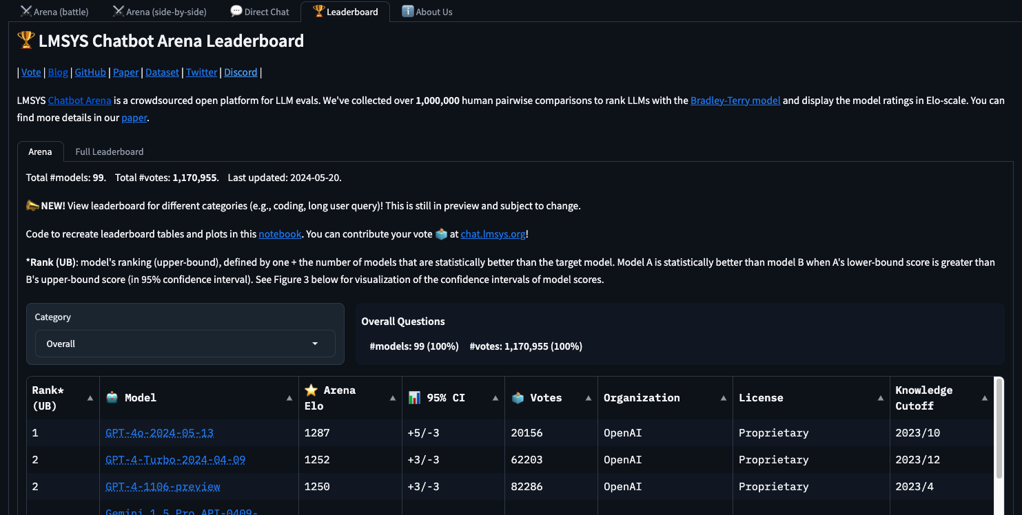
Benchmarks for massive models – Leaderboards URL

Slide 76
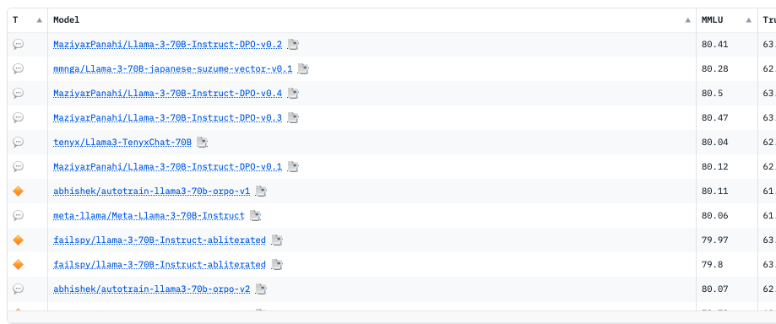
Benchmarks for OpenSource models – Leaderboards URL

Slide 77

Lets code this out?

